Slide 1
Mantid Release Presentation
Release 3.7
ISIS

Slide 2
What is this meeting
Release 3.5
Released on Monday 5^{h} October
Present the changes and improvements

Slide 3
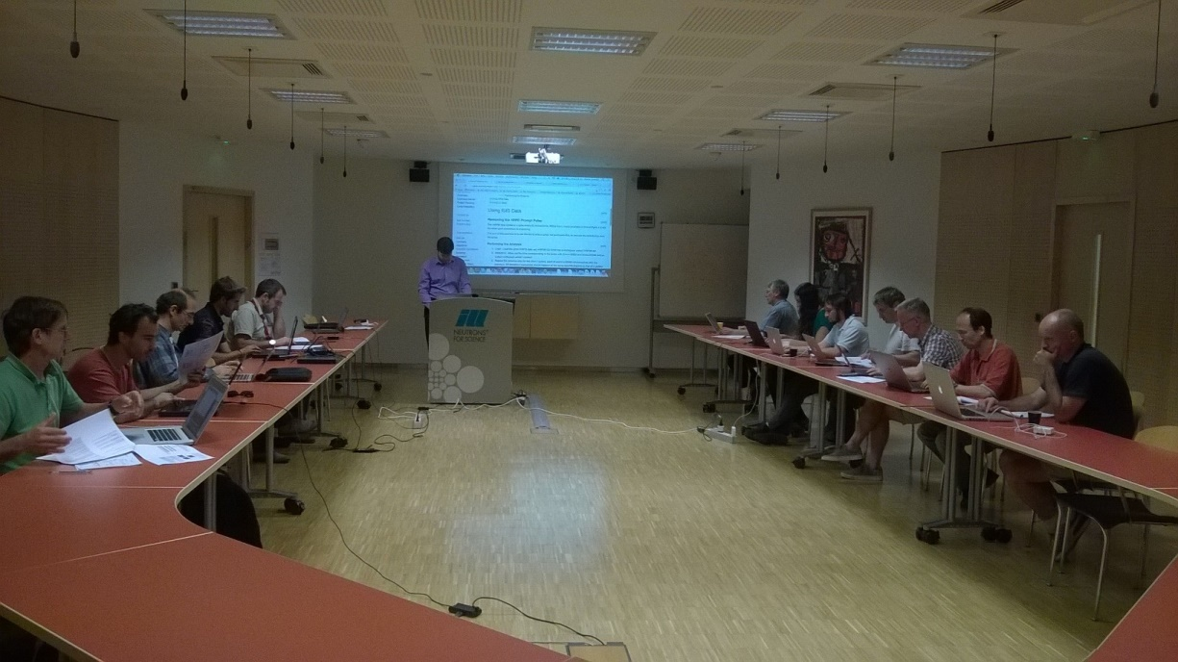
Training Courses
Dates
Last Course
September 2015
Next courses
Jan/Feb 2016
To Book
Email: nick.draper@stfc.ac.uk
More details at www.mantidproject.org

Slide 4








Supported Platforms
Staying the same
RHEL 6 64bit
RHEL 7 64bit
OSX Mountain Lion +
Windows 7 64 bit
Ubuntu 14.04 64 bit
Limited support for
Windows 8 64 bit
Fedora 20
Not officially supported, but works
Windows 10

Slide 5
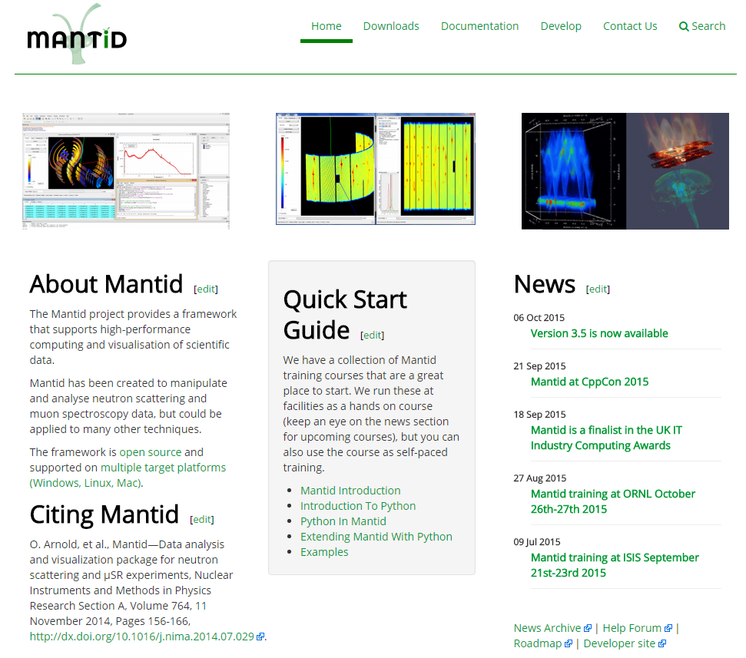
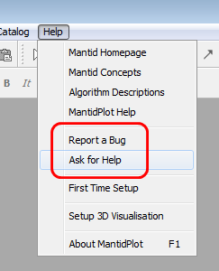
Mantid Support Forum
forum.mantidproject.org
help.mantidproject.org

Slide 6
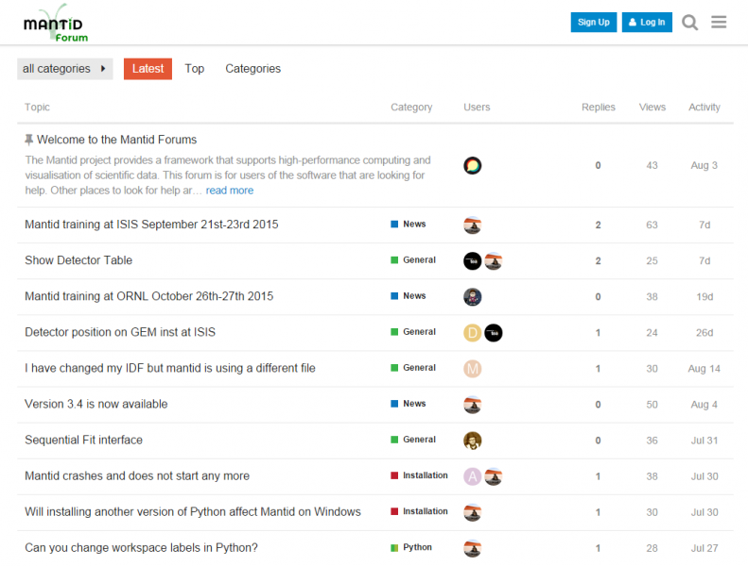
Mantid Support Forum

Slide 7
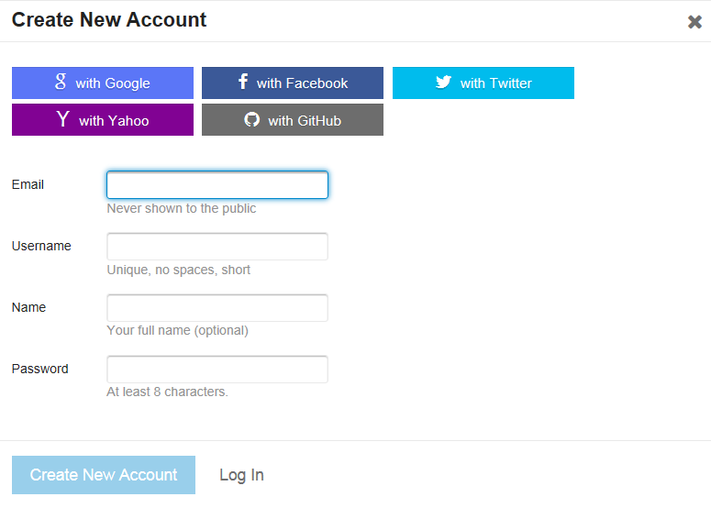
Mantid Support Forum

Slide 8
User Interface

Slide 9

Windows Installation
Each Windows install now self contained
Multiple installs without worry of picking up correct libs
Installer process streamlined
Fewer button clicks
Progress reports for removing old version
Future versions won’t have to click ‘ok’ to start removal
Shortcuts that were attached to task launcher were broken
fix is to simply delete and drag a new one on from desktop

Slide 10
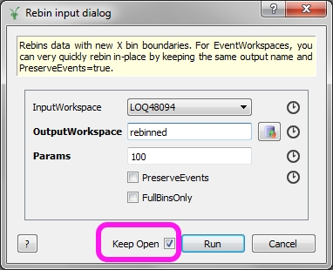
Algorithm Dialogs
Notes:
DEMO
Now simpler to run an algorithm a second time with slightly different parameters
Saves have to go and keep clicking run on the algorithms box

Slide 11
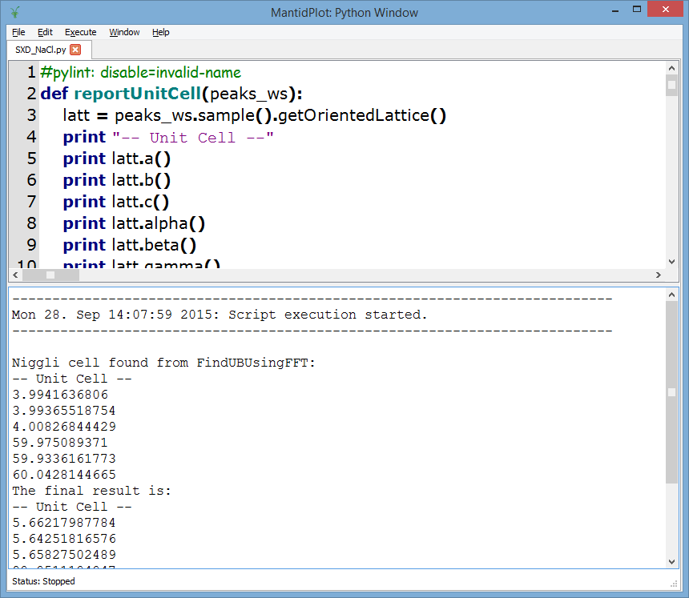
Script Window
Notes:
Files that were open when MantidPlot shutdown now open automatically
Easier to close using cross icon on tab

Slide 12
Script Window
You can now abort scripts!
Execute Menu → Abort
Or “Ctrl+D” shortcut
Warning – it’s a request
It can take a moments to satisfy
If an algorithm doesn’t cancel effectively → tell us
Notes:
First bullet point
DEMO
Caveat

Slide 13
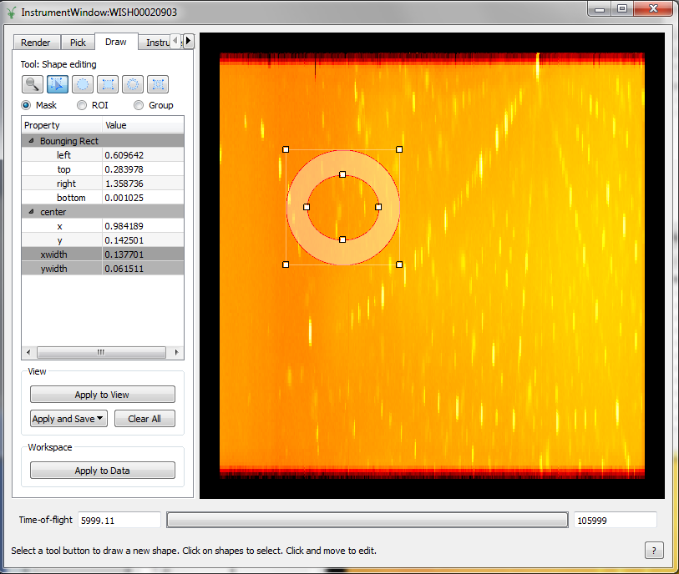
Instrument View
Notes:
Mask/Group" is now called "Draw“
New ROI mode
Technically no new functionality – just clear as to pupose of task

Slide 14
Instrument View
Notes:
Mask/Group" is now called "Draw“
New ROI mode
Technically no new functionality – just clear as to pupose of task

Slide 15
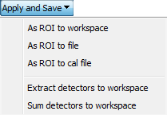
Instrument View
Notes:
Mask/Group" is now called "Draw“
New ROI mode
Technically no new functionality – just clear as to purpose of task
Menu options now simply apply to current mode

Slide 16
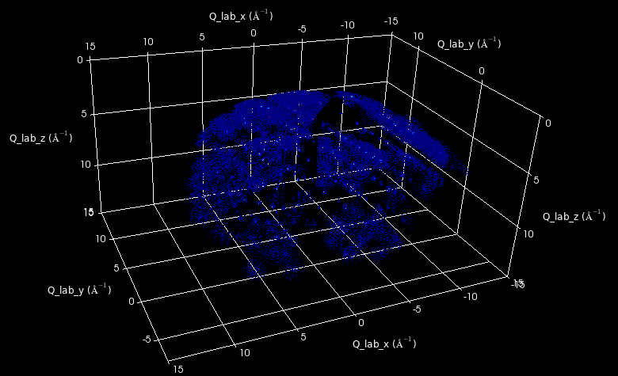
VSI

Slide 17
Framework

Slide 18
Multiple Scattering
New algorithm for corrections due to absorption and multiple scattering - MayersSampleCorrection
Based on J. Mayers OpenGenie correct routine
Cylindrical sample, elastic scattering
Multiple scattering requires isotropic scatterer
Multiple scattering correction is optional
http://docs.mantidproject.org/nightly/algorithms/MayersSampleCorrection-v1.html
Needs more widespread testing!
Notes:
See documentation for more detail, reference link and usage example

Slide 19
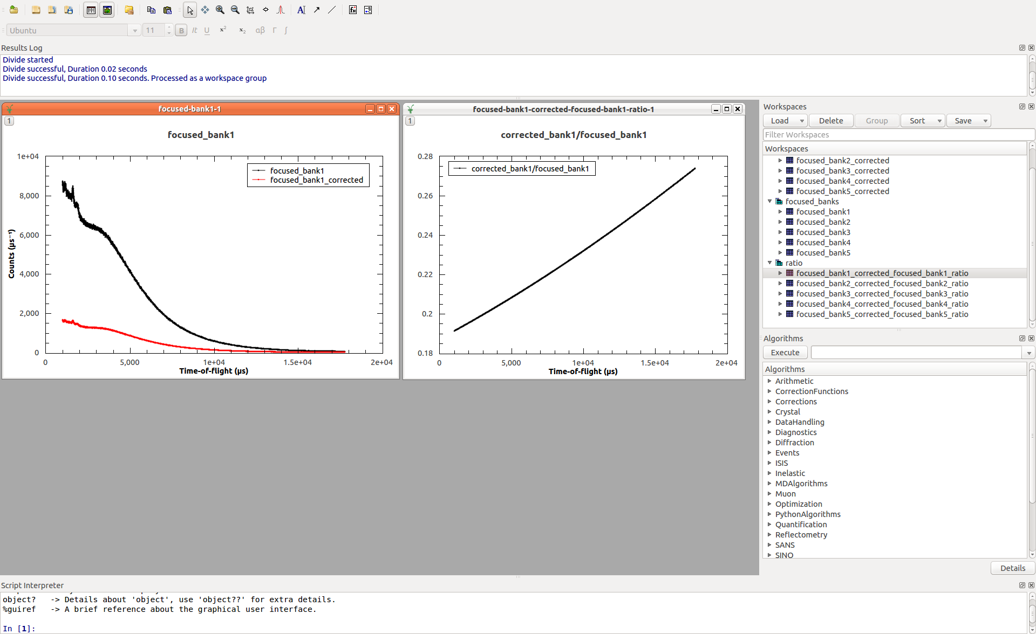
Multiple Scattering
Example: corrected data & ratio for bank1 of POLARIS vanadium run

Slide 20
Indirect Inelastic

Slide 21
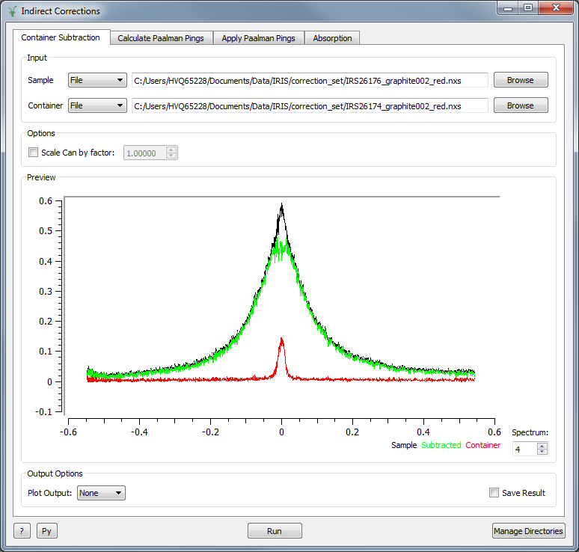
Corrections
New interface
Interfaces > Indirect > Corrections
Container Subtraction
Simple interface that only subtracts the container

Slide 22
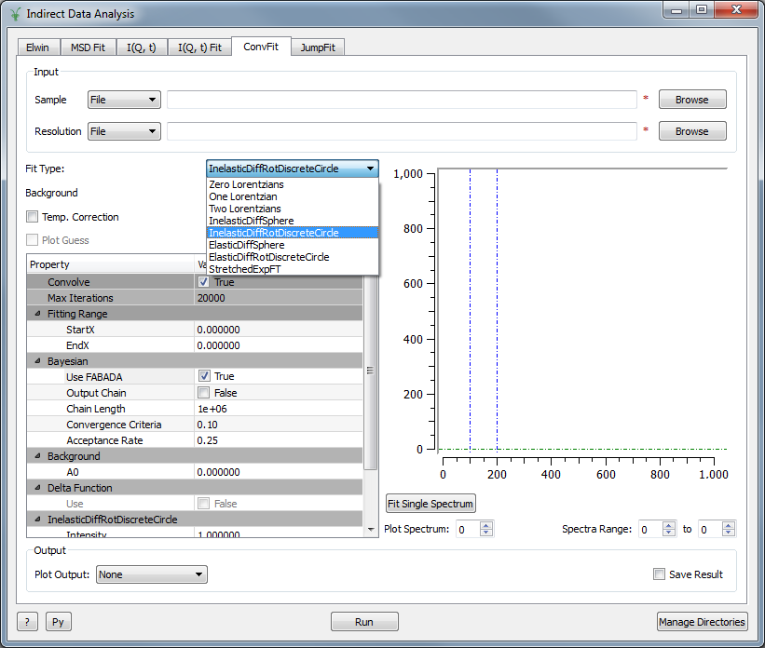
Data Analysis
ConvFit
Support for Quasi elastic fit functions
Mantid Algorithm
Bayesian Analysis
FABADA in ConvFit and I(Q, t) Fit

Slide 23
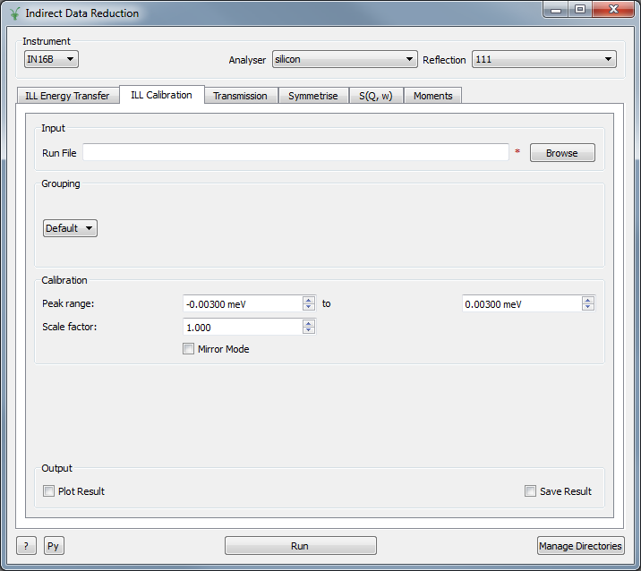
Data Reduction
Facility Support for the ILL
ILL Calibration tab
IN16B

Slide 24
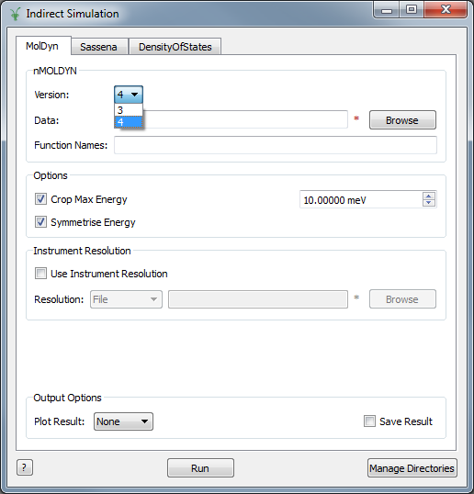
Simulation
nMOLDYN
Support for nMOLDYN 4
Density Of states
DOS spectra output for TOSCA comparison

Slide 25
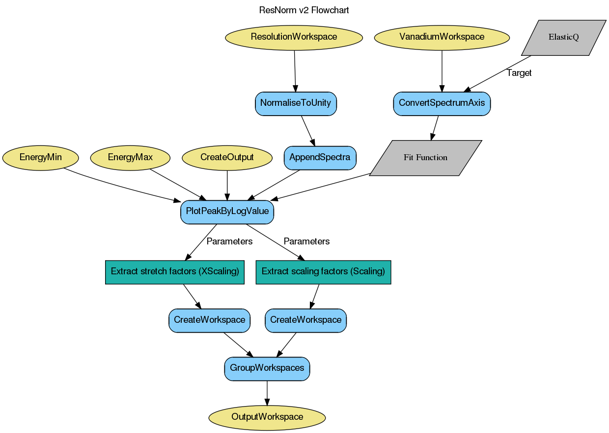
Documentation
Workflow diagrams
Corrections Sample logs
Sample, Container and Corrections file

Slide 26
Reflectometry

Slide 27
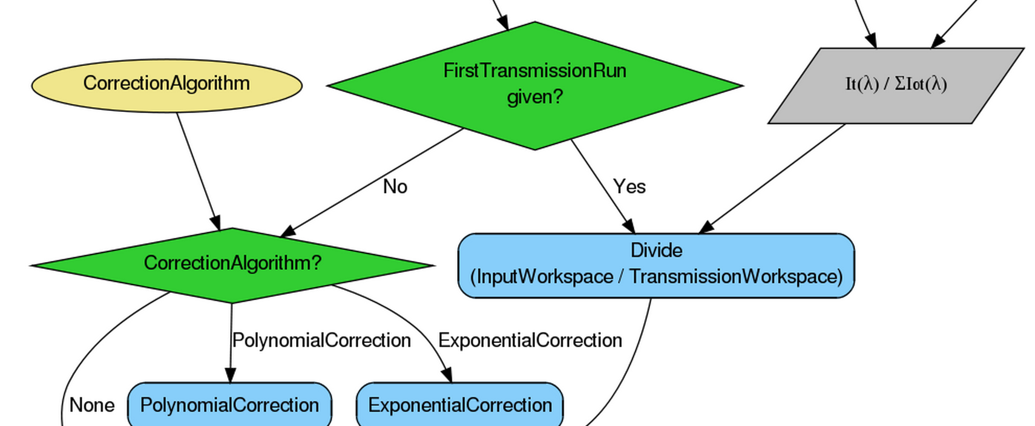
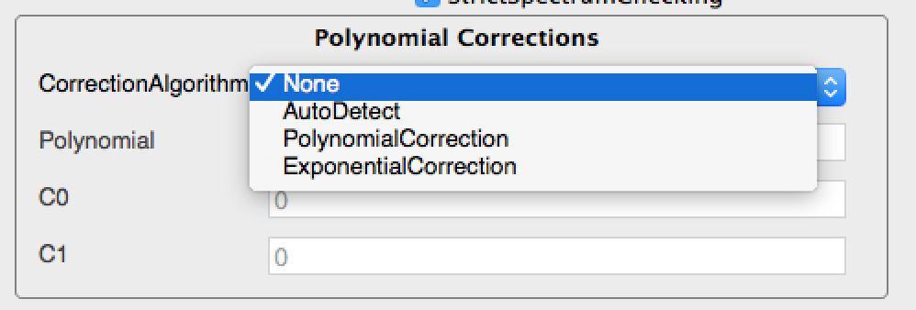
Transmission Correction

Slide 28
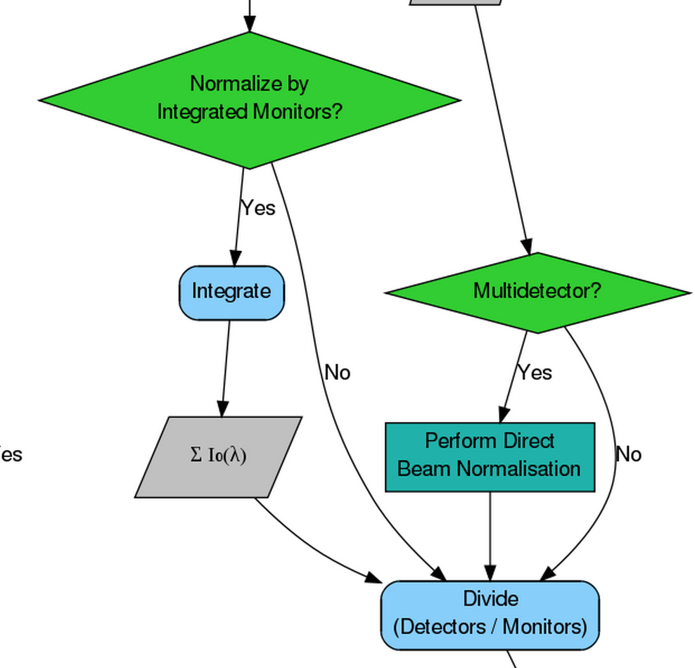

Monitor Normalization

Slide 29
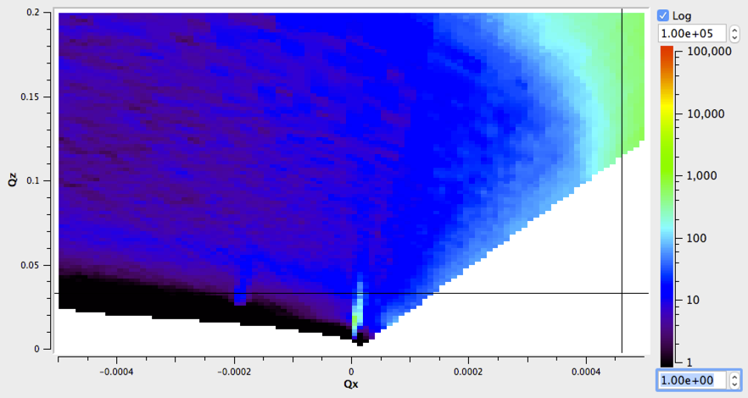
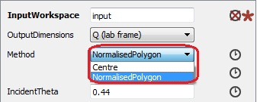
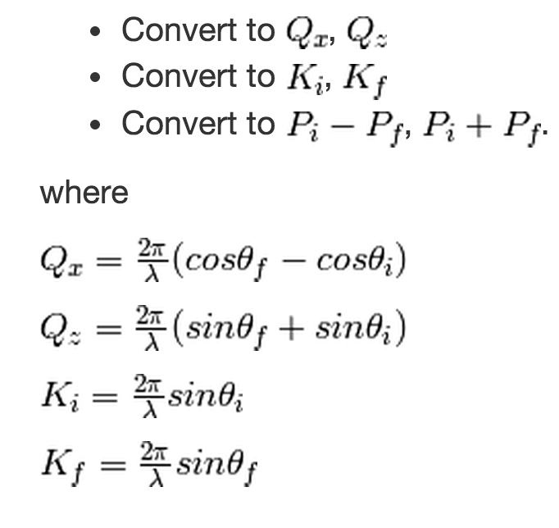
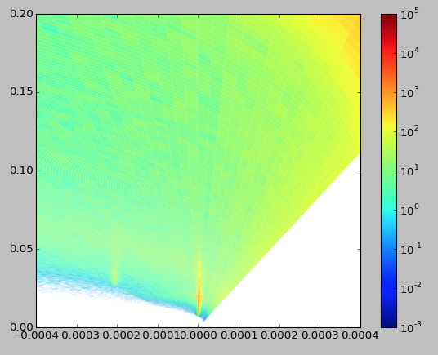
ConvertToReflectometryQ (SofQW)

Slide 30
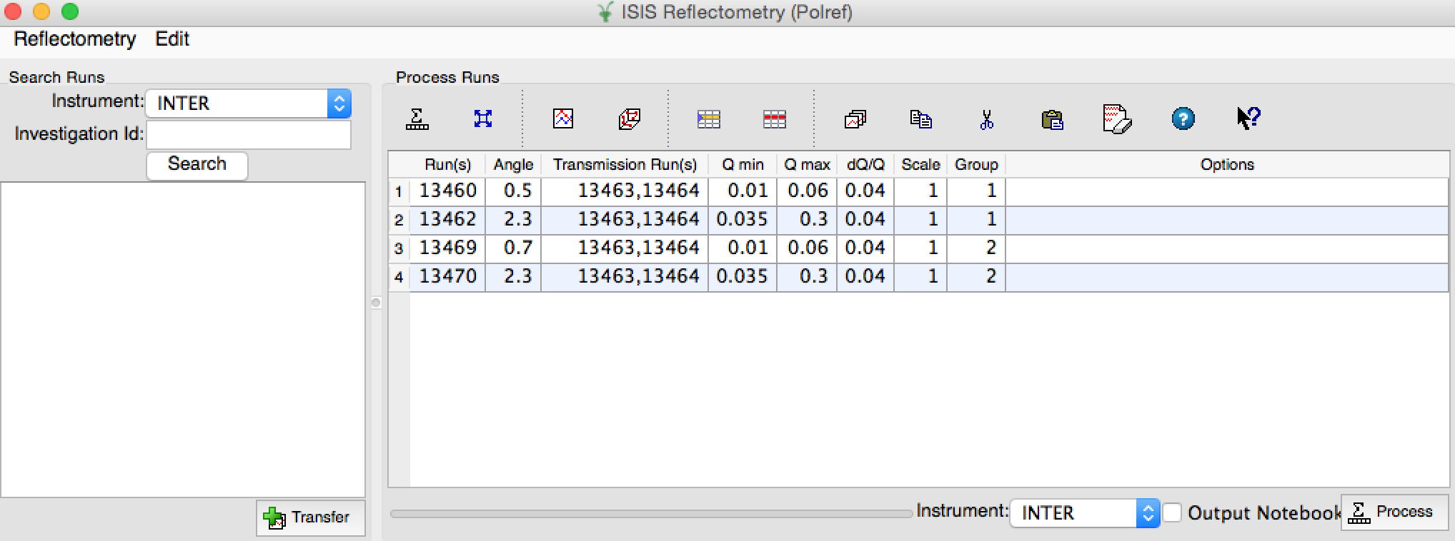
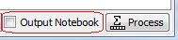
Electronic Notebooks

Slide 31
Diffraction

Slide 32
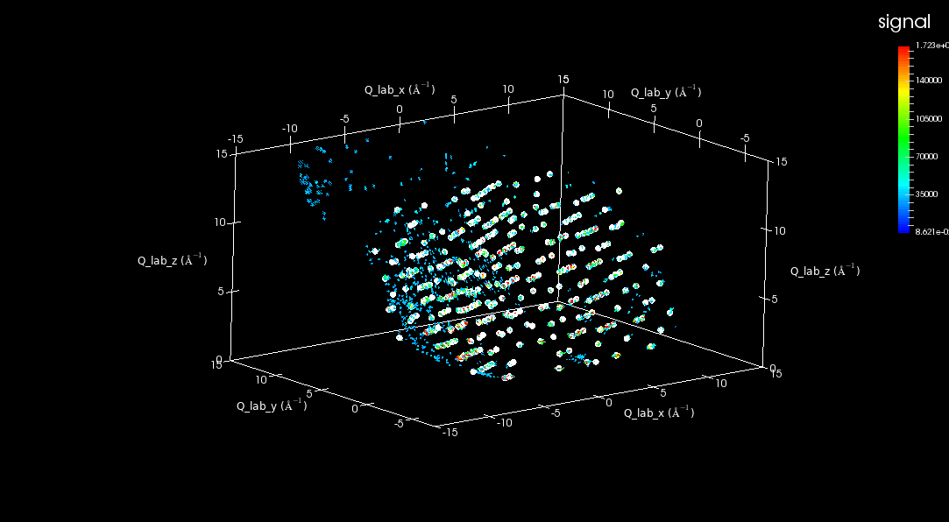
3D Visualisation

Slide 33
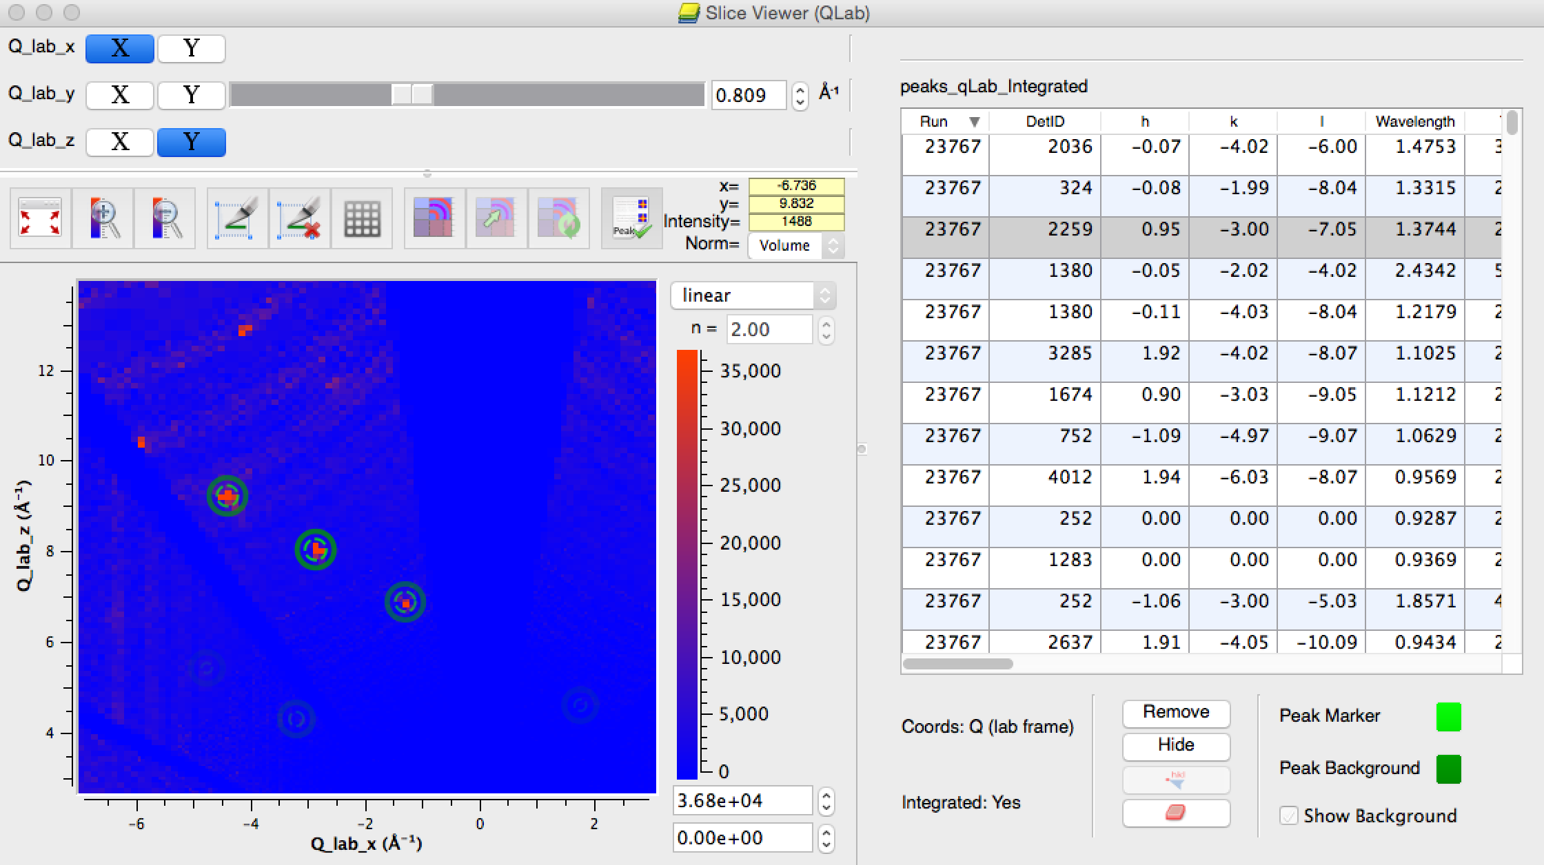
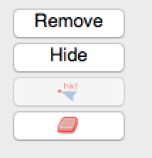
PeaksViewer Interactive Modes

Slide 34
Other Diffraction Improvements
Major bug fix for BinMD and SliceMD
“Group” has been exposed to python
Other improvements to “SpaceGroup” and “PointGroup” (see documentation)
TransposeMD and ReplicateMD added
New Engineering UI for calibration and focusing
Migration of Powder scripts to Mantid 3.5

Slide 35
SANS

Slide 36
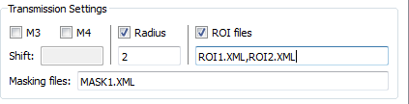
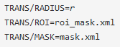
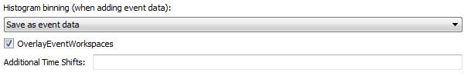
Extended Transmission Settings (Reduction Settings Tab)
User File Commands:
Overlay added event workspaces (Add Runs Tab)

Slide 37
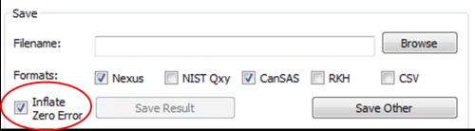
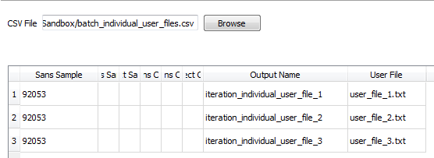
Inflate zero-errors
Support for loading multi-period event data
Individual User Files in Batch mode

Slide 38
Muon

Slide 39
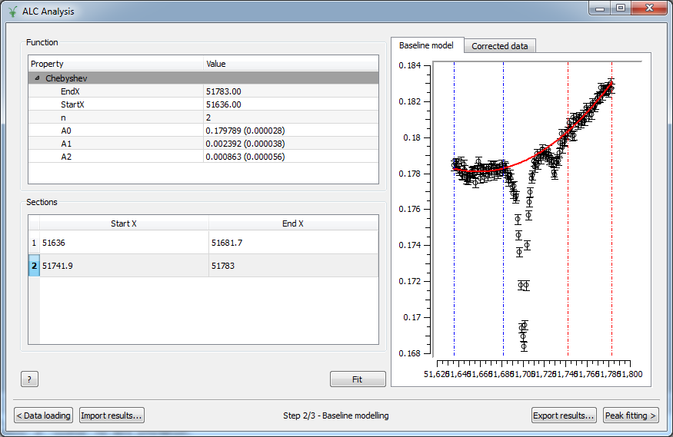
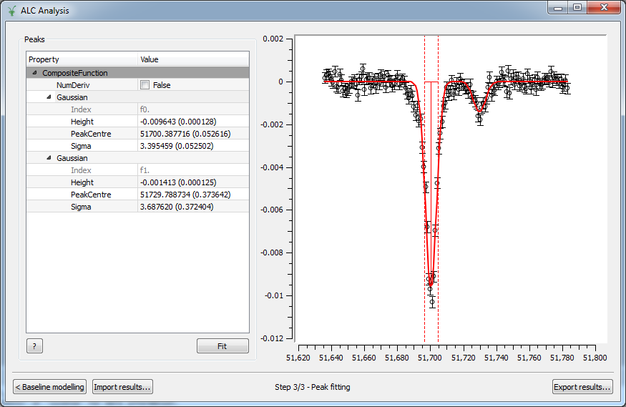
ALC
Error bars

Slide 40
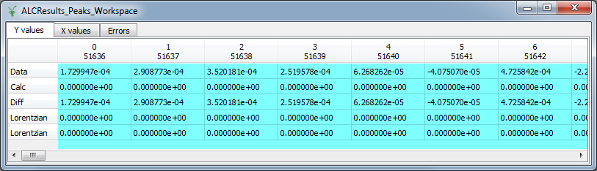
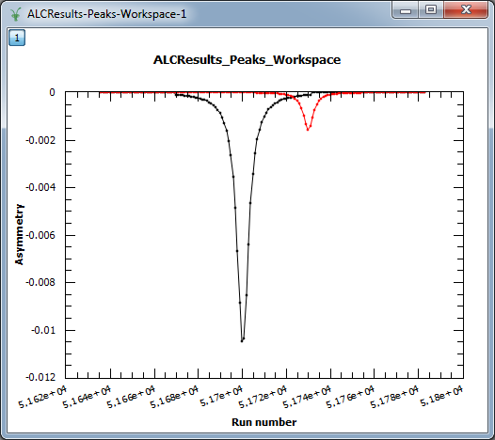
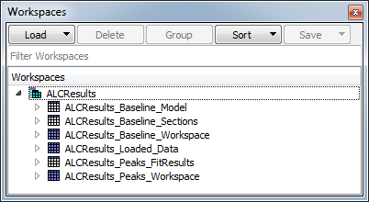
ALC
Peaks exported as separate spectra

Slide 41
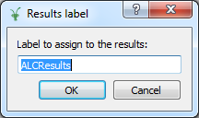
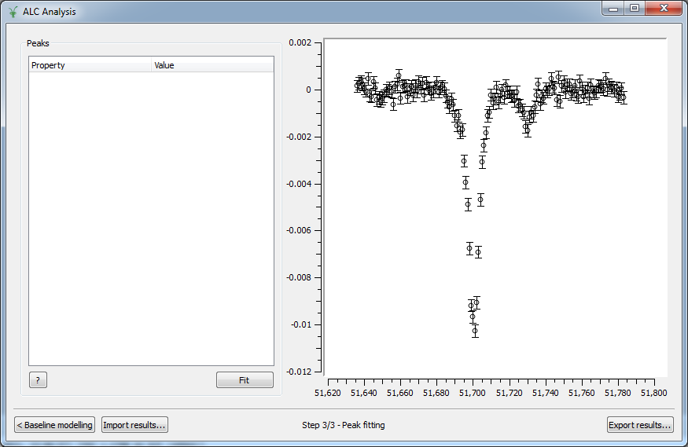
ALC
Import results

Slide 42
IPython Notebooks

Slide 43

IPython Notebooks
Record results, analysis, notes
Electronic laboratory notebook
Features:
User editable
Cross-platform
Simple to re-execute
Annotation, including equations and tables
Inline figures using matplotlib
Printable or easily export to PDF
Use Mantid’s Python API
Now adding specific support to MantidPlot

Slide 44
IPython Notebooks
Notebooks generated in two places:
GenerateIPythonNotebook algorithm
ISIS Reflectometry (Polref) interface
Demo

Slide 45
Next Release

Slide 46
Release v3.6
Planned Release Date: End Jan/ Early Feb 2015
Mantid Scientific Steering Committee
ORNL
Most likely dates 20-21st January

Slide 47

Thank you

